Slide 1
OSA Series 2: Chemistry Update 24/7/20
D. Klug, E. Tse

Slide 2
OSA Series 2: Chemistry Update 31/7/20
Dana’s Synthesis
Ed’s Synthesis
D. Klug, E. Tse

Slide 3
OSA Series 2: Chemistry Update 21/8/20
D. Klug, E. Tse

Slide 4
OSA Series 2: Chemistry Update 21/8/20
D. Klug, E. Tse

Slide 5
OSA Series 2: Chemistry Update 4/9/20
Proposed Analogues
D. Klug, E. Tse

Slide 6
OSA Series 2: Chemistry Update 4/9/20
D. Klug, E. Tse

Slide 7
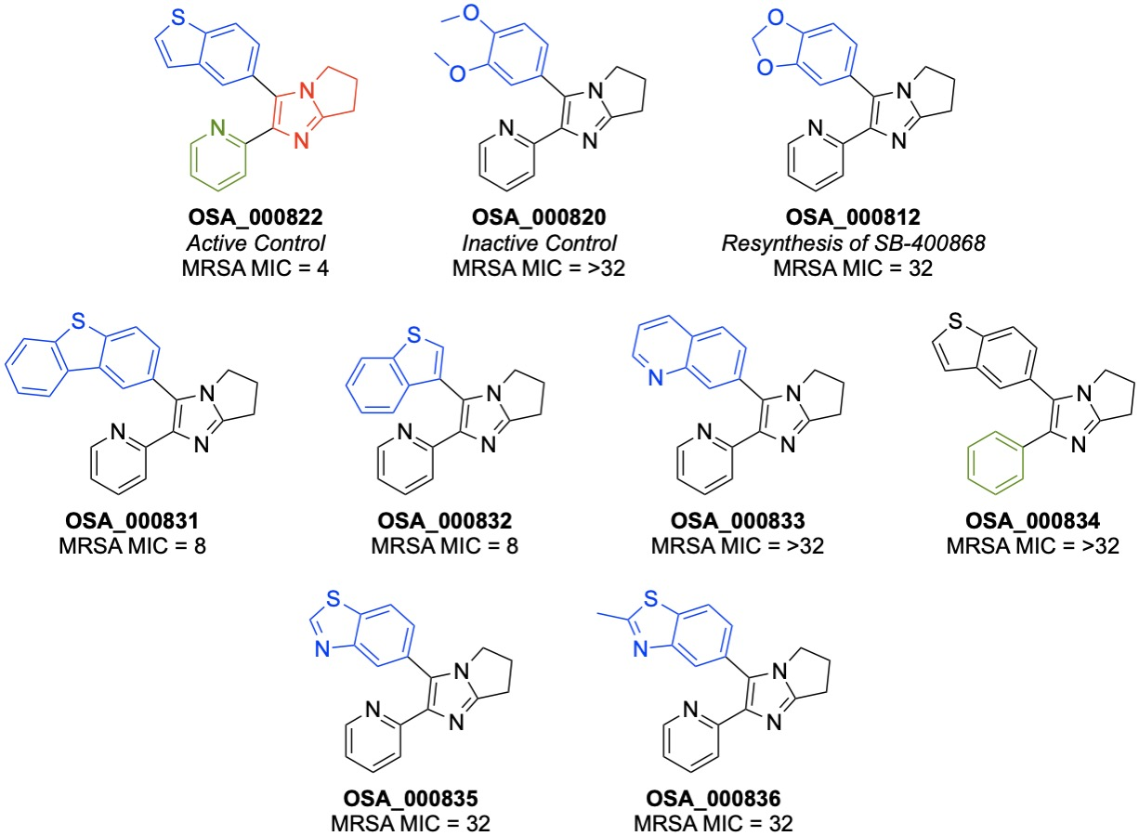
OSA Series 2: Chemistry Update 11/9/20
Compounds delivered to Paul Stapleton (MRSA assay) 9/9/20
D. Klug, E. Tse

Slide 8
OSA Series 2: Chemistry Update 11/9/20
Notebook page | Ar-Br | Ar-Bpin | Results
DMK127-3
DMK131-2 |  |  | Decomposition
DMK134-1
D. Klug, E. Tse

Slide 9
OSA Series 2: Chemistry Update 11/9/20
D. Klug, E. Tse

Slide 10
OSA Series 2: Chemistry Update 18/9/20
Compound | R | Notebook page | Results
2a | Me | DMK128 | Separable mixture of isomers
2b | Tr | DMK130 | Desired pdt
2c | Ts | DMK137 | Needs purification
3a | Me | DMK | Dimer
3b | Tr | DMK131 | Inconsistent
4a | Me | DMK139 | No reaction (to be repeated)
4b | Tr | DMK135 | Decomposition
D. Klug, E. Tse

Slide 11
OSA Series 2: Chemistry Update 18/9/20
D. Klug, E. Tse

Slide 12
OSA Series 2: Chemistry Update 18/9/20
D. Klug, E. Tse

Slide 13
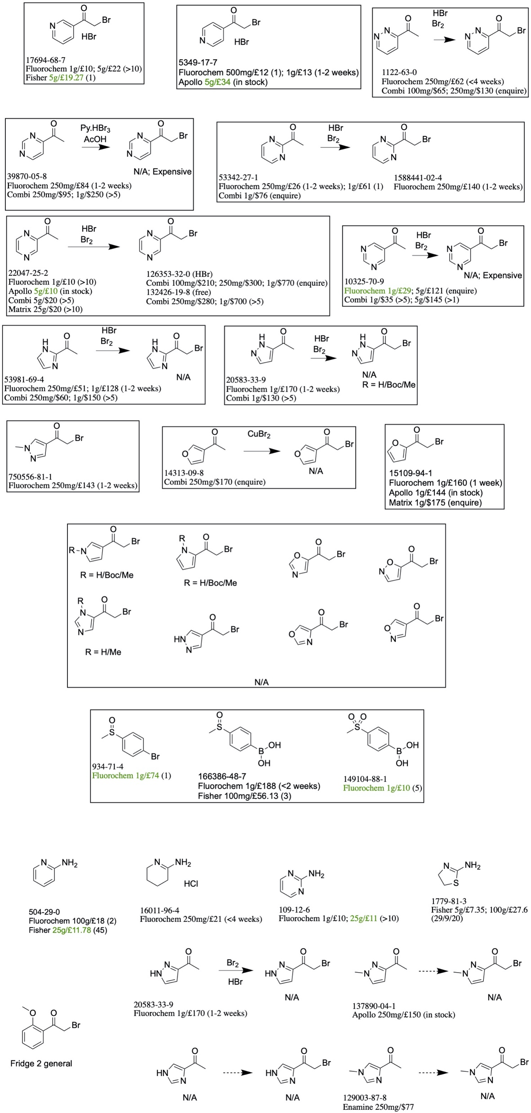
OSA Series 2: Chemistry Update 18/9/20
D. Klug, E. Tse

